Slide 1
"Digital Media Primer" Yue-Ling Wong,
Copyright (c)2016 by Pearson Education, Inc. All rights reserved.
© 2016 Pearson Education, Inc., Hoboken, NJ. All rights reserved.

Slide 2
Chapter 1
Background
Part 2
Bits basic concepts
© 2016 Pearson Education, Inc., Hoboken, NJ. All rights reserved.

Slide 3
In this lecture, you will find answers to these questions
What are bits?
What do encode and decode mean?
What is the significance of the number of bits?
© 2016 Pearson Education, Inc., Hoboken, NJ. All rights reserved.

Slide 4
Bits
In computer systems, data is stored and represented in binary digits, called bits.
To understand how bits can be used to store information, let's use eye signals as an analogy.
© 2016 Pearson Education, Inc., Hoboken, NJ. All rights reserved.

Slide 5
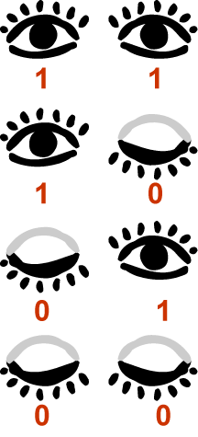
Two eyes, Four Combinations of Open and Closed
© 2016 Pearson Education, Inc., Hoboken, NJ. All rights reserved.

Slide 6
Encoding Your Eye Signals
To communicate with your friends with your eye signals, you will need to assign meanings (or messages) to the different combinations of open and closed eyes.
We call this process encoding the message.
© 2016 Pearson Education, Inc., Hoboken, NJ. All rights reserved.

Slide 7
Two eyes, Four Combinations of Open and Closed
You may assign a different meaning to each combination of open and close eyes.
© 2016 Pearson Education, Inc., Hoboken, NJ. All rights reserved.

Slide 8
Two eyes, Four Combinations of Open and Closed
You may assign "OMG" to this
© 2016 Pearson Education, Inc., Hoboken, NJ. All rights reserved.

Slide 9
Two eyes, Four Combinations of Open and Closed
You may assign "Yes" to this
© 2016 Pearson Education, Inc., Hoboken, NJ. All rights reserved.

Slide 10
Two eyes, Four Combinations of Open and Closed
You may assign "No" to this
© 2016 Pearson Education, Inc., Hoboken, NJ. All rights reserved.

Slide 11
Two eyes, Four Combinations of Open and Closed
You may assign "May be" to this
© 2016 Pearson Education, Inc., Hoboken, NJ. All rights reserved.

Slide 12
Two eyes, Four Combinations of Open and Closed
Or, in another situation,
You may assign nothing to this
You may assign "Like" to this
You may assign "Not Like" to this
You may assign nothing to this
© 2016 Pearson Education, Inc., Hoboken, NJ. All rights reserved.

Slide 13
Two eyes, Four Combinations of Open and Closed
Or, in yet another situation,
You may assign "red" to this
You may assign "black" to this
You may assign "blue" to this
You may assign "yellow" to this
© 2016 Pearson Education, Inc., Hoboken, NJ. All rights reserved.

Slide 14
Decode Your Eye Signals
In order to use your eye signals to communicate with your friends, they will need to know how to interpret your eye signals.
We call it decoding your eye signals.
© 2016 Pearson Education, Inc., Hoboken, NJ. All rights reserved.

Slide 15
Two eyes, Four Combinations of Open and Closed
No matter what messages, with 2 eyes, you can encode no more than 4 different messages.
© 2016 Pearson Education, Inc., Hoboken, NJ. All rights reserved.

Slide 16
How many eyes do you need if you have 16 possible colors to signal to your friends?
© 2016 Pearson Education, Inc., Hoboken, NJ. All rights reserved.
Notes:
4 eyes

Slide 17
Hand Signals
Suppose we consider only two possible poses for each finger: raised up or bent down.
How many different messages can you encode with 10 fingers?
© 2016 Pearson Education, Inc., Hoboken, NJ. All rights reserved.
Notes:
2¹⁰ = 1024

Slide 18
Now returning to Bits
© 2016 Pearson Education, Inc., Hoboken, NJ. All rights reserved.

Slide 19
Bits
In computer systems, data is stored and represented in binary digits, called bits.
A bit has two possible values, 0 or 1.
© 2016 Pearson Education, Inc., Hoboken, NJ. All rights reserved.

Slide 20
Recall Our Eye Signals
Say, we give the open eye a 1 and the closed eye a 0.
We can think of each eye is a bit.
© 2016 Pearson Education, Inc., Hoboken, NJ. All rights reserved.

Slide 21
Recall Our Eye Signals
Say, we give the open eye a 1 and the closed eye a 0.
We can think of each eye is a bit.
We can think of our 2-eye signal system is a 2-bit system.
As you see, 2-bit system can encode 4 messages (or choices of things.)
© 2016 Pearson Education, Inc., Hoboken, NJ. All rights reserved.

Slide 22
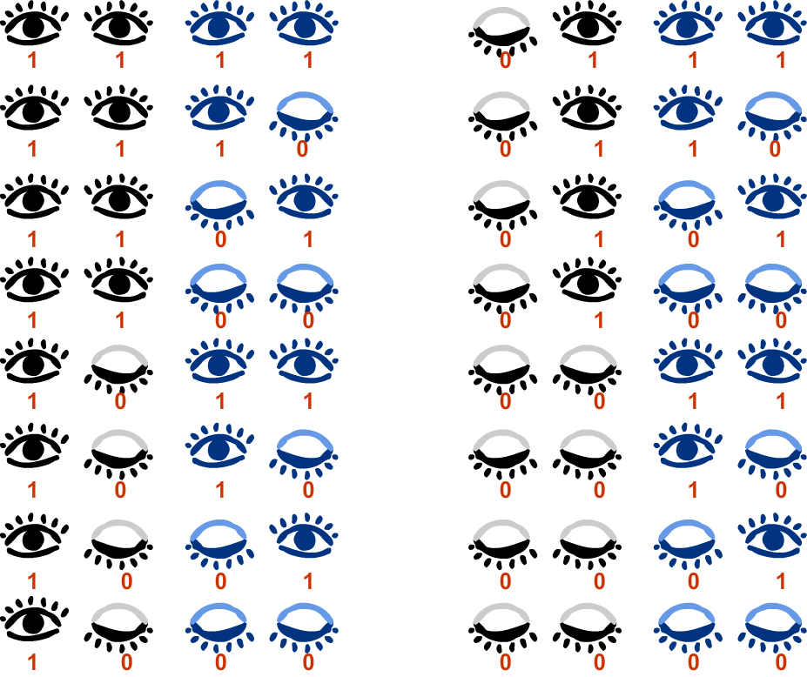
4 bits can encode 16 (2⁴) different messages
© 2016 Pearson Education, Inc., Hoboken, NJ. All rights reserved.

Slide 23
Number of possible values = 2^{(number of bits)}
More bits can encode more information.
More bits require more computer storage.
© 2016 Pearson Education, Inc., Hoboken, NJ. All rights reserved.

Slide 24
Bytes
1 byte = 8 bits
© 2016 Pearson Education, Inc., Hoboken, NJ. All rights reserved.

Slide 25
So Many Bits...
The number of bits to encode information especially for digital media are very large.
We use prefixes, such as mega and giga, to better conceive the number of bits and bytes of computer storage.
© 2016 Pearson Education, Inc., Hoboken, NJ. All rights reserved.

Slide 26
Prefixes
Prefix Name | Abbreviation | Size
Kilo | K | 2¹⁰ = 1,024
Mega | M | 2²⁰ = 2,048
Giga | G | 2³⁰ = 1,073,741,824
Tera | T | 2⁴⁰ = 1,099,511,627,776
Peta | P | 2⁵⁰ = 1,125,899,906,842,624
Note the size is computed by the exponential of 2.
The exponent is increased in a step of 10,
i.e. 2¹⁰ , 2²⁰ , 2³⁰ , 2⁴⁰ , 2⁵⁰ , ...
It is NOT 10³ , 10⁶ , 10⁹ , 10¹² , 10¹⁵ , ...
© 2016 Pearson Education, Inc., Hoboken, NJ. All rights reserved.

Slide 27
Review Questions
Note to instructor:
Depending on your preference, you may want to go over the review questions at the end of this lecture as an instant review or at the beginning of next lecture to refresh students' memory of this lecture.
© 2016 Pearson Education, Inc., Hoboken, NJ. All rights reserved.

Slide 28
Review Question
The word bit comes from the shortening of the words _____ _____.
© 2016 Pearson Education, Inc., Hoboken, NJ. All rights reserved.
Notes:
binary digit

Slide 29
Review Question
The smallest unit in a binary system is a _____.
A. bit
B. byte
© 2016 Pearson Education, Inc., Hoboken, NJ. All rights reserved.
Notes:
A

Slide 30
Review Question
A bit has these two possible values: _____ and _____.
© 2016 Pearson Education, Inc., Hoboken, NJ. All rights reserved.
Notes:
0, 1

Slide 31
Review Question
Eight _____ equals one _____.
A. bytes; bit
B. bits; byte
© 2016 Pearson Education, Inc., Hoboken, NJ. All rights reserved.
Notes:
B

Slide 32
Review Question
If you want to use hand signals to communicate only two possibilities—like or not like—to your friend, what is the minimum number of finger(s) you need? _____
We can call this hand-signal system ___-bit.
© 2016 Pearson Education, Inc., Hoboken, NJ. All rights reserved.
Notes:
1, 1

Slide 33
Review Question
If you want to encode only 2 colors, what is the minimum number of bit(s) you need? _____
© 2016 Pearson Education, Inc., Hoboken, NJ. All rights reserved.
Notes:
1

Slide 34
Review Question
If you want to encode only 8 colors, what is the minimum number of bit(s) you need? _____
© 2016 Pearson Education, Inc., Hoboken, NJ. All rights reserved.
Notes:
3

Slide 35
Review Question
Most grayscale images use 8-bit color. This means there can be _____ possible different gray tones in the image.
© 2016 Pearson Education, Inc., Hoboken, NJ. All rights reserved.
Notes:
256 or 2⁸

Slide 36
Review Question
(i) How many number of bits in this binary notation?
0011010
(ii) How many possible values can these many bits represent?
© 2016 Pearson Education, Inc., Hoboken, NJ. All rights reserved.
Notes:
(i) 7 bits
(ii) 2⁷ = 128

Slide 37
Review Question
Which of the following sizes is the largest?
A. 24 GB
B. 24 MB
C. 240 MB
D. 2400 KB
© 2016 Pearson Education, Inc., Hoboken, NJ. All rights reserved.
Notes:
A

